Slide 1
On Multiple Kernel Learning with Multiple Labels
Lei Tang, Jianhui Chen and Jieping Ye

Slide 2
Kernel-based Methods
Kernel-based methods
Support Vector Machine (SVM)
Kernel Linear Discriminate Analysis (KLDA)
Demonstrate success in various domains
Text, Images, micro-array
Performance is sensitive to the provided kernel
Finding a good kernel can be critical to the classification task
Notes:
Kernel-based methods such has show success
If you are not familiar with kernels, you can consider it as the similarity matrix between different data instances.
For kernel-based methods, finding out a good kernel can be critical.
But in reality, there can be various ways to construct kernels.

Slide 3
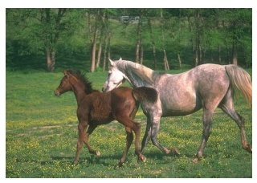
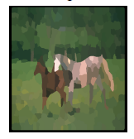
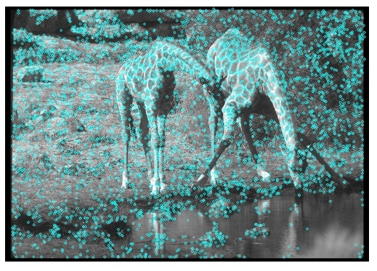
Various Descriptors of Images
Shape
Color
Texture
Segments
Interest points
Segment
Interest Points
(Pyramid Kernel)
(borrowed from Francis Bach’s talk)

Slide 4
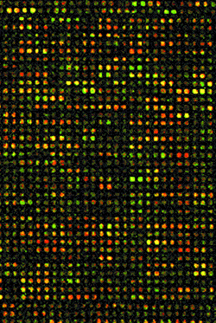
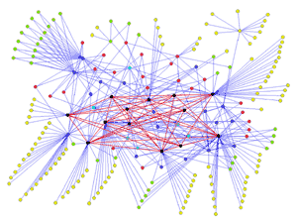
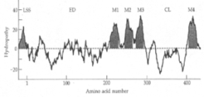
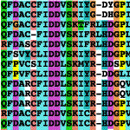
Heterogeneous Data Fusion
Protein Sequence: BLAST scores
Pairwise Comparison Kernel
Protein-Protein Interactions
Interaction Kernel
mRNA expression profiles
Gaussian Kernel
Hydropathy profile
FFT Kernel
K
?
Multiple Kernel Learning:
learn an optimal kernel from the base kernels
Notes:
Kernel-based learning methods represent data by means of a kernel matrix or function, which defines similarities between pairs of genes, proteins, … Such similarities can be established using a broad spectrum of data (examples later on), as long as the corresponding kernel matrix is positive definite: it’s ok! In that case, we can interprete it is the inner products in some high dimensional space, in which we can train our favorite linear classification algorithm…
Kernel matrix <-> kernel function
So we can have a very heterogeneous set of data up here, and every kernel function/matrix is geared towards a specific type of data, thus extracting a specific type of information from a data set.
Just like this each set of data describes the genome partially, in a heteregeneous way, so does each kernel, but in a homogeneous way (all compatible matrices). So, here we have a chance to fuse the many partial descriptions of the data: by combining/fusing/mixing those compatible kernel matrices in a way that is statistically optimal, computationally efficient and robust, we can try to find a kernel K that best represents all of the information available for a given learning task. We’ll explain further on how this can be accomplished.

Slide 5
Multiple Kernel Learning
Input:
multiple base kernels K₁, K₂, …, K_{p}
Label information
Assume: Optimal kernel is linear combination of base kernels
Output: Optimal kernel G
Can be formulated as a nice optimization problem
QCQP (Quadratically constrained Quadratic Program)
SILP (semi-infinite linear programming)
Projected Gradient
Shows success on various domains
Notes:
Normally the kernels are scaled, theta are subject to certain constraints

Slide 6
Classification with Multiple Labels
Existing works mainly focus on binary classification
In reality, often multiple labels
Multi-class categorization
Multi-label categorization
Decompose into multiple binary classification tasks
C1, C2, C3, C4
SVM₁
SVM₂
SVM₃
SVM₄
Prediction
Tasks
C₁
C₂
C₃
C₄

Slide 7
Kernel Learning with Multiple Labels
Kernel learning with multiple labels
Two options:
All classification tasks share the same kernel
Each classification task has a specific kernel
Research Questions:
Same Kernel or Independent Kernel?
Partially Sharing the Kernel among Different Labels?
Need to find out a way to do the systematic study!

Slide 8
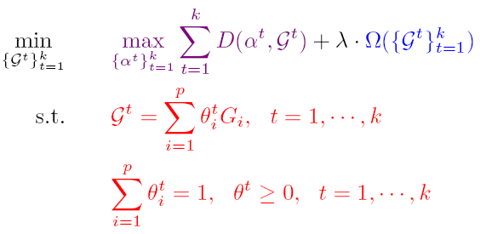
Framework of MKL with Multiple Labels
+
Kernel
Regularization
SVM Loss
Optimal Kernels are represented as the convex combination of base kernels
SVM dual objective

Slide 9
Representing the Kernel Difference
The kernel weights of
different labels
Specific Kernel
Shared kernel

Slide 10
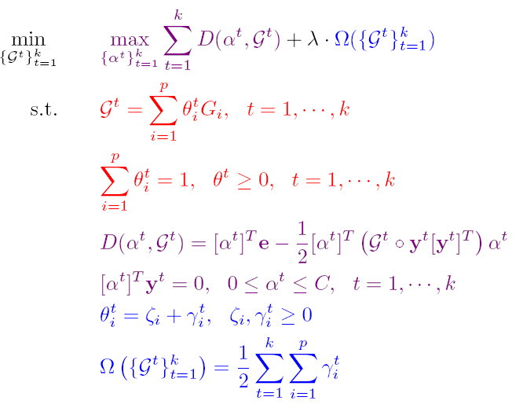
Framework of MKL with Multiple Labels
: Trade-off parameter
: Each label select kernel independently
: All labels select the same kernel
Otherwise, partially sharing the kernel.
Same / Partial / Independent
Models

Slide 11
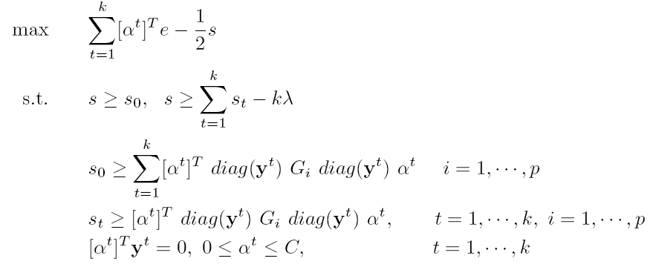
QCQP Formulation
Too many quadratic constrains!
Not scalable due to extensive memory requirement

Slide 12
A Scalable Algorithm
Formulate it as kernel weight minimization over a set of infinite number of SVMs
Solve via Cutting-Plane Strategy
Given some constraints, find out the best possible kernel combination (LP problem)
Given the kernel combination, find out the SVM which violates the constraints most ( = SVM Problem), and add the corresponding constraints
Existing optimization software or SVM package can be utilized directly

Slide 13
Experiment Setup
Three Models: Independent / Partial / Same
9 data sets, including text, image, micro-array
6 - 36 labels, 8 - 62 kernels
Various kinds of kernels
Diffusion kernels
Gaussian kernels
Linear kernels
Kernels based on structure comparison

Slide 14
Q1: Is kernel regularization necessary?
Only when labeled samples are few, there’s a difference

Slide 15
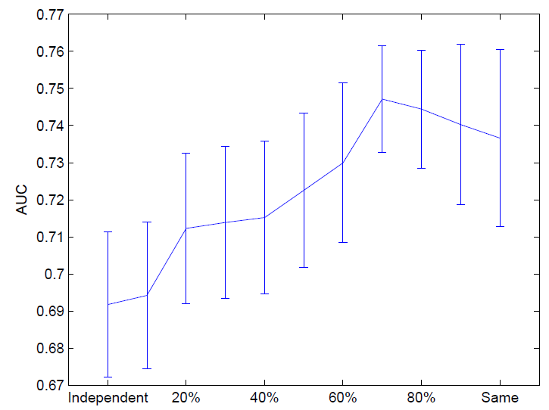
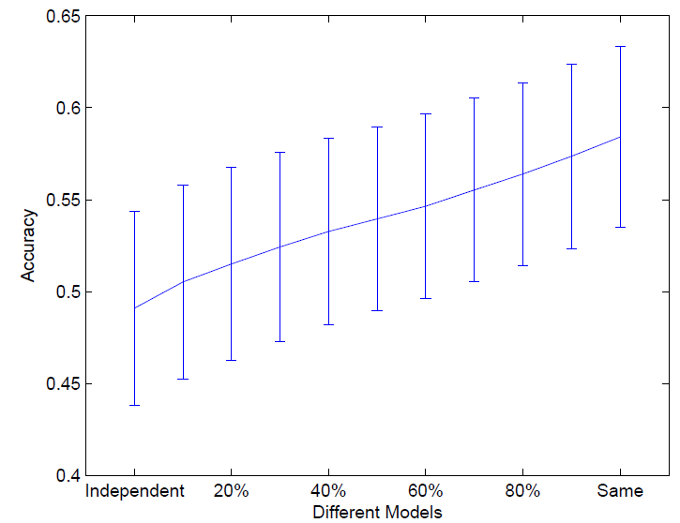
Q2: Who is the winner?
Ligand Data
USPS Data
Sharing the same kernel tends to win!

Slide 16
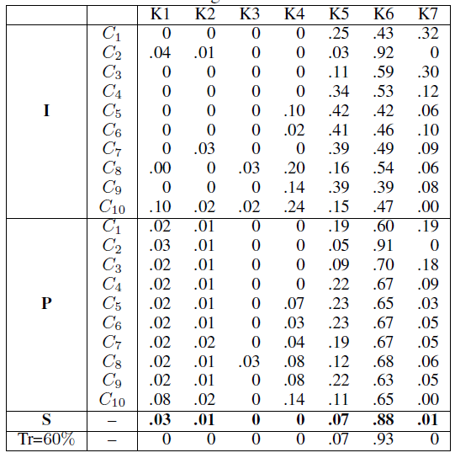
Q3: Why Same works better?
Selecting Kernels Independently
Selecting the Same kernel
is like increasing training samples for kernel learning
Partially Sharing
The Kernel
Same Kernel
60% vs. 5% labeled samples
Notes:
Shows you one case when 5% data are used for training

Slide 17
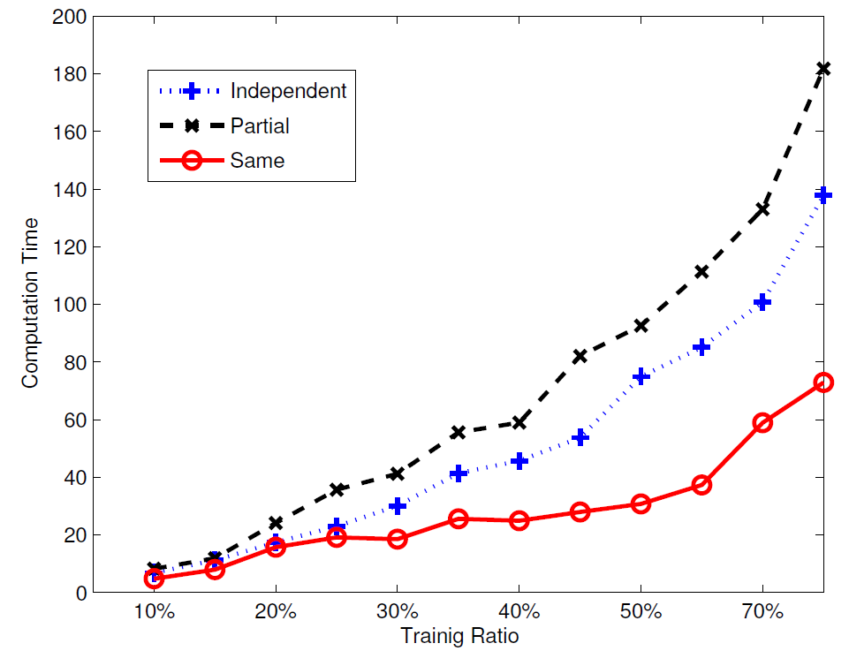
Q4: Which Model is More Efficient?
Independent model can be paralleled easily.
Same Model is most efficient.
Adding more constraints forces the problem to converge more quickly

Slide 18
Q5: A special case – Average Kernel
Average Kernel performs reasonably well, especially when the candidate kernels are good
Average Kernel deteriorates with when base kernels are noisy

Slide 19
Conclusions
Propose a framework for multiple kernel learning with multiple labels
Same / Partial / Independent Model
Differ only when labeled data are few
Same kernel across labels is the best
Average kernel works reasonably well; can be sensitive to noisy kernels
Bring-home Message:
For classification with multiple labels,
Learn The Same Kernel!

Slide 20
Thanks!
Acknowledgement
NSF IIS-0612069, IIS-0812551, CCF-0811790
NIH R01-HG002516, HM1582-08-1-0016

