Slide 1
Scalable Learning of Collective Behavior based on Sparse Social Dimensions
Lei Tang and Huan Liu
Data Mining and Machine Learning Laboratory
Computer Science & Engineering
Arizona State University
The 18th ACM International Conference on
Information and Knowledge Management CIKM, Hong Kong, Nov. 5th, 2009

Slide 2
Collective Behavior
Examples of Behavior
Joining a sports club
Buying some products
Becoming interested in a topic
Voting for a presidential candidate
Collective Behavior
Behavior in a social network environment
Behavior correlation between connected actors
Particularly in social media
Notes:
In this work, we study collective behavior in social media

Slide 3
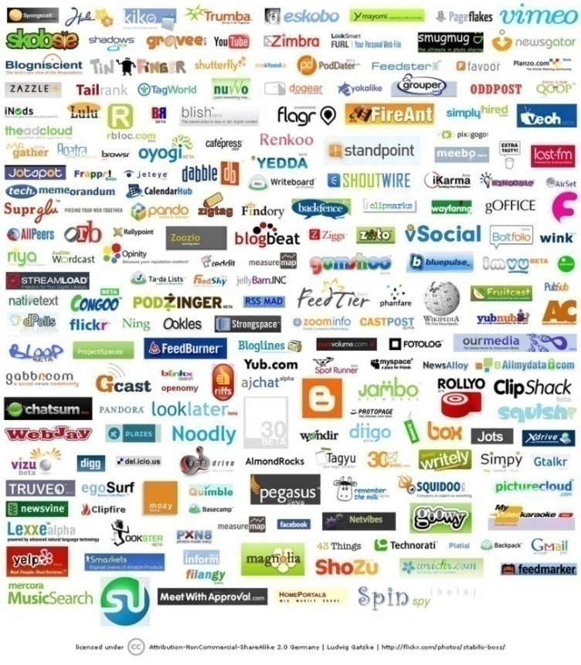
Behavior in Social Media
Social media encourage user interaction, leading to social networks between users
Problem: How to exploit social network information for behavior prediction?
Can benefit
Targeting
Advertising
Policy analysis
Sentimental analysis
Trend Tracking
Behavioral Study
Notes:
Social media is gaining increasing attentions these years. In social media, users are encouraged to interact with each other, leading to social networks between users.

Slide 4
Collective Behavior Prediction
User behavior or preference can be represented by labels (+/-)
Click on an ad
Interested in certain topics
Subscribe to certain political views
Like/Dislike a product
Given:
A social network (i.e., connectivity information)
Some actors with identified labels
Output:
Labels of other actors within the same network

Slide 5
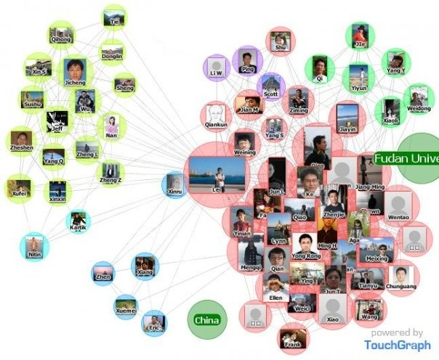
Existing Work: SocioDim
Social Dimension Approach (KDD09):
Key observations:
one user can be involved in multiple different relations
Distinctive relations have different correlations with behavior
Need to differentiate relations (affiliations)
Social Dimension is introduced to represent the latent affiliations of actors
ASU
Fudan
University
High School
Friends
Notes:
Use asu event

Slide 6
Social Dimensions
ASU
Fudan
 | ASU | Fudan University | High School | Yahoo! Inc.
Lei | 1 | 1 | 1 | 0
Actor₁ | 1 | 0 | 0 | 1
Actor₂ | 0 | 1 | 0 | 0
…… | …… | …… | …… | ……
One actor can be involved in multiple affiliations
High School
Challenge: Relation (affiliation) information is unknown.
How to extract the social dimensions?
Actors of the same affiliation interact with each other frequently
→ Community Detection
Which affiliations are informative for behavior prediction?
Let label information help → Supervised Learning
Notes:
Each dimension represents one affiliation.
There are several challenges to be addressed.

Slide 7
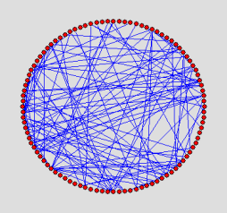
SocioDim Framework
Labels
Supervised
Learning
classifier
Community
Detection
Prediction
Predicted
Labels
Social
Dimensions
Training:
Extract social dimensions to represent potential affiliations of actors
Soft clustering (modularity maximization, mixture of block model)
Build a classifier to select those discriminative dimensions
SVM, logistic regression
Prediction:
Predict labels based on one actor’s social dimensions

Slide 8
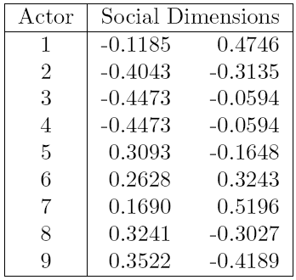
Extraction of Social Dimensions
Existing approach use modularity maximization
Use top eigenvectors of a modularity matrix as social dimensions
Outperform representative methods based on collective inference
Limitations:
Dense Representation
E.g. 1 M actors, 1000 dimensions, requires 8G memory
Eigenvector computation can be expensive
Difficult to update whenever the network changes
Need a scalable algorithm to find sparse social dimensions
7
4
8
5
1
3
9
6
2
Notes:
How do we find sparse social dimensions

Slide 9
Bounded Number of Affiliations
One actor is likely to be involved in multiple affiliations
Number of affiliations should be bounded by the connections one actor has.
Actor₁: 1 connection, at most 1 affiliation
Actor₂: 3 connections, at most 3 affiliations
………….
2
1
Notes:
The number of connections with one actor, in a sense, tells us how many affiliations are involved with this actor.
Inspire us to look at edges

Slide 10
Edge Partition
7
4
7
4
8
8
5
1
3
5
1
3
9
9
6
2
6
2
Each edge is involved in only one relation
Partition edges into disjoint sets
Actors | Social Dimensions
1 | 1 | 1
2 | 1
3 | 1
4 | 1
5 |  | 1
6 |  | 1
7 |  | 1
8 |  | 1
9 |  | 1
Guaranteed Sparse Representation
Notes:
Though nodes are assigned to multiple affiliations, edges tend to be reside in only one affiliations.

Slide 11
Sparsity of Social Dimensions
Power law distribution in large-scale social networks
Density Upperbound (More details in the paper)
E.g. YouTube network
1, 128, 499 nodes, 2, 990, 443 edges,
Extracting 1,000 social dimensions
Density is upperbounded by 0.54%.
Less than 6 among 1000 entries are non-zero
Notes:
Explain k. How do we partition edges into disjoint sets?

Slide 12
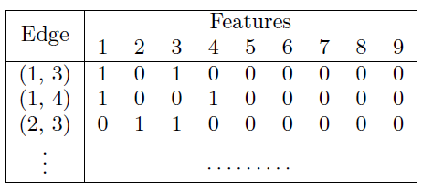
EdgeCluster Algorithm
7
4
7
4
8
8
5
1
3
5
1
3
9
9
6
2
6
2
Disjoint Partition Algorithm
(like k-means clustering )
Edge-Centric View

Slide 13
k-means exploiting sparsity
Apply k-means algorithm to partition edges
Millions of edges are the norm
Need a scalable and efficient k-means implementation
Exploit the sparsity of edge-centric data
Build feature-instance mapping (like inverse-index table in IR)
Only compute the distance between a centroid to those relevant instances with sharing features
please refer to paper for details
Each data instance has only two features

Slide 14
Overview of EdgeCluster Algorithm
Apply k-means algorithm to partition edges into disjoint sets
One actor can be assigned to multiple affiliations
Sparse (Theoretically Guaranteed)
Scalable via k-means variant
Space: O(n+m)
Time: O(m)
Easy to update with new edges and nodes
Simply update the centroids

Slide 15
Experiments
Questions to investigate:
Comparable performance with existing methods (dense social dimensions) ?
Sparsity of social dimensions?
Scalability?
Social Media Data Sets
Blog Catalog: 10K nodes, 333K links
Flickr: 80K nodes, 6M links
YouTube: 1.1 M nodes, 3M links
Use blog category or group subscriptions as behavior labels

Slide 16
Performance
EdgeCluster
ModMax
EdgeCluster
ModMax
NodeCluster
NodeCluster
Notes:
Explain X-Y axis first, then discuss about each curve

Slide 17
Performance on YouTube

Slide 18
Sparsity
500 social dimensions | BlogCatalog (10k) | Flickr (80k) | YouTube (1M)
ModMax | 41.2MB | 322.1MB | 4.6GB
EdgeCluster | 4.9MB | 44.8MB | 39.9MB
Reduction Rate | 88% | 86% | 99%
Density | 6% | 7% | 0.4%

Slide 19
Scalability
 | BlogCatalog 10k nodes 333k links | Flickr 80k nodes 6M links | YouTube 1M nodes 3M links
ModMax | 194.4 sec | 40 minutes | N/A
EdgeCluster | 357.8 sec | 3.6 hours | 10mins

Slide 20
Conclusions
Contributions:
Propose a novel EdgeCluster algorithm to extract sparse social dimensions for classification
Develop a k-means algorithm via exploiting the sparsity
Core Idea: Partition edges into disjoint sets
Actors are allowed to participate in multiple affiliations
Representation becomes sparse with theoretical justification
Time and space complexity is linear
Performance is comparable to dense social dimensions
Can be applied to sparse networks of colossal size
1 M network finished in 10 minutes
50MB memory space

Slide 21
Questions?
Data sets and code are available at Lei Tang’s homepage.
http://www.public.asu.edu/~ltang9/
(or Just search Lei Tang)
Acknowledgement: AFOSR

Slide 22
References
Lei Tang and Huan Liu. Scalable Learning of Collective Behavior based on Sparse Social Dimensions. In CIKM’09, 2009.
Lei Tang and Huan Liu. Relational Learning via Latent Social Dimensions. In KDD’09, Pages 817–826, 2009.
Macskassy, S. A. and Provost, F. Classification in Networked Data: A Toolkit and a Univariate Case Study. J. Mach. Learn. Res. 8 (Dec. 2007), 935-983. 2007
Neville, J. and Jensen, D. 2005. Leveraging relational autocorrelation with latent group models. In Proceedings of the 4th international Workshop on Multi-Relational Mining, 2005.

Slide 23
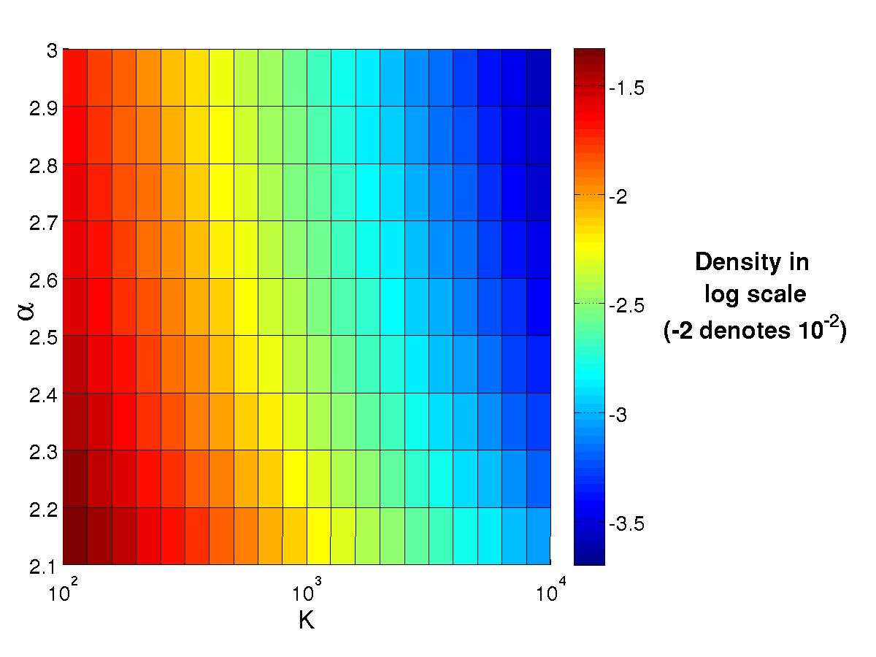
Function of Density Upperbound

